Slide 1

TOWS Analysis
Amazon Delivery Services

Slide 2

Introduction
Founded by Jeff Bezos
On 5 July 1994, Bellevue, Washington, United States
The first book sold on Amazon.com was Douglas Hofstadter's Fluid Concepts and Creative Analogies: Computer Models of the Fundamental Mechanisms of Thought.

Slide 3
SO [Strength Opportunities]
SO.1. Taking over 3rd party companies
SO.2. Market leader
SO.3. The advantage in the food industry
SO.4. First choice in the course of the pandemic

Slide 4
WO[Weakness Opportunities]
WO.1. A takeover of companies who can improve the quality
WO.2. Employment Opportunities via podcasts
WO.3. Employment on lower wages
WO.4. Include other companies with the same model

Slide 5
ST[Strength Threats]
ST.1. 3rd party companies may change the product quality
ST.2. The cyber threat to 3rd party companies
ST.3. Few chances of loss even though cybercrime has happened
ST.4. More preference

Slide 6
WT[Weakness Threats]
WT.1. Easy employment via Walmart
WT.2. Easy model chances of cyber threat
WT.3. Quality satisfaction according to the government regulations
WT.4. Same product made by Walmart with better quality

Slide 7
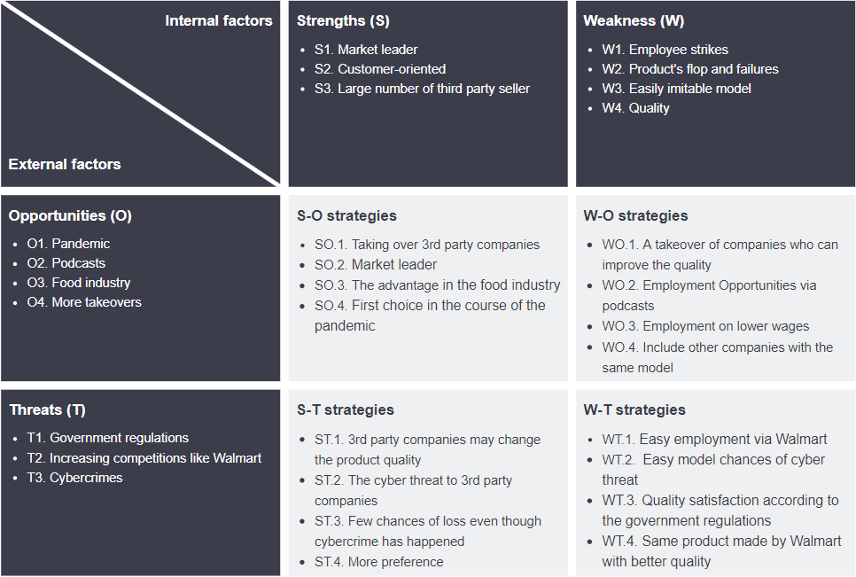

Slide 8
THANK YOU
A brand for a company is like a reputation for a person. You earn reputation by trying to do hard things well.
- Jeff Bezos

